Slide 1
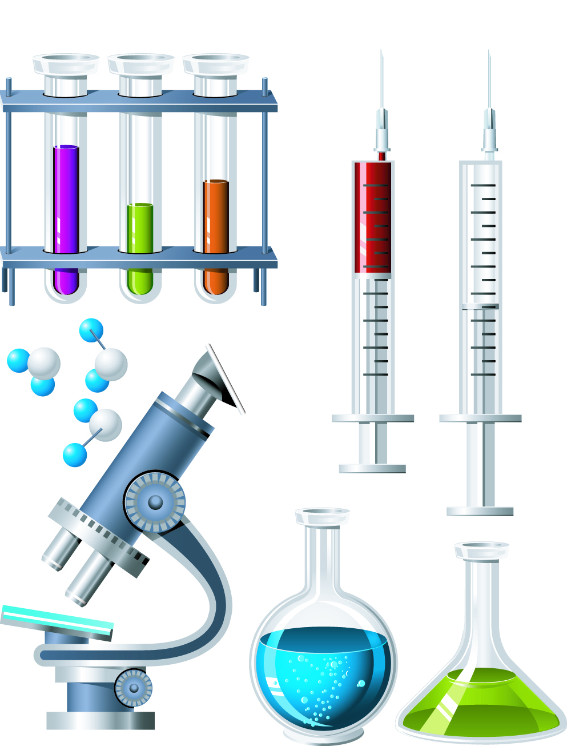
Chapter 2
Chemistry of Life
2.1 Matter and Organic Compounds
Learning Objectives for section 2.1 (part one):
Matter
Atoms
Elements
Compounds
Bonding
Chemical reactions

Slide 2
In Chapter 1 we learned that to be considered a living thing an object must show all of the six characteristics of life.
One of those characteristics states that all living things are made up of cells.
If that is true, if we learn what cells are made of then we can learn what all organisms are made of.
MATTER
I don’t expect many of you appreciate that in previous years I taught you that all things are made up of Matter and matter is anything that has mass and takes up space.

Slide 3
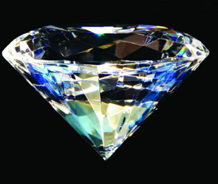
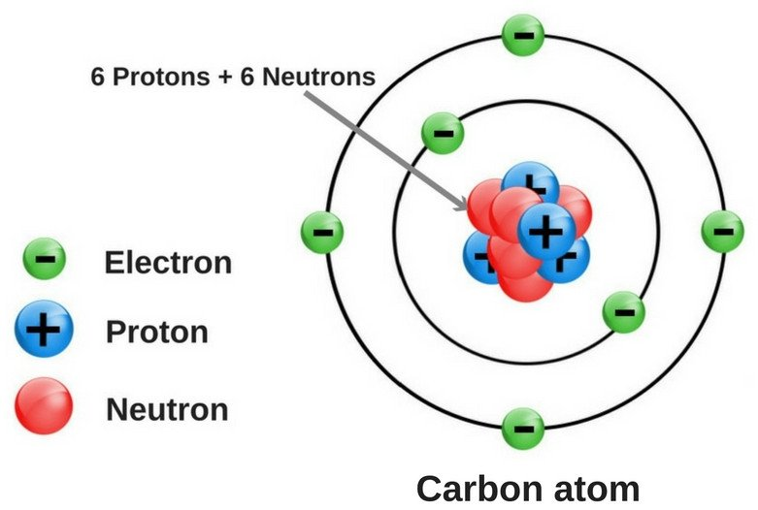
If matter makes up all things, both living and non-living, then what makes up matter? The answer to that is ATOMS.
Atoms are the smallest particle of an element. Whether there is one atom or 1 billion of the same type of atom, it is called an element.
A diamond contains only the element carbon. (billions of carbon atoms)
A single carbon atom is also known as an element.

Slide 4
Notice that this carbon atom has parts of its own. There are three particles that make up an atom; proton, neutron, electron. They are two areas in an atom.
The nucleus of an atom is found at the center or core.
The electron cloud is divided into energy levels.

Slide 5
 | Particle Location | Charge | Atomic Mass
Proton | Nucleus | Positive (+) | One
Neutron | Nucleus | No charge | One
Electron | Electron Cloud | Negative (-) | Zero
Of the three subatomic particles, only electrons can be lost, gained or shared.
To split the nucleus of an atom would release catastrophic amounts of energy. (atomic bomb)

Slide 6
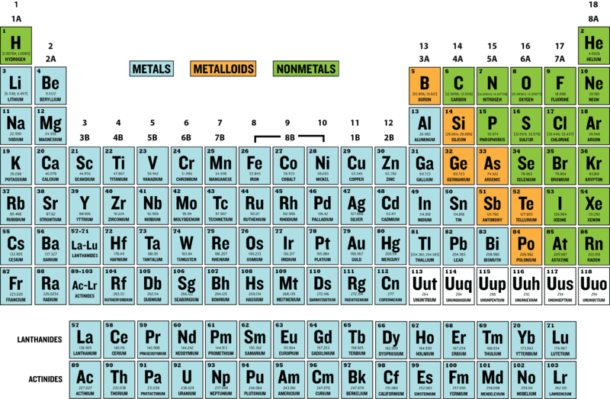
Periodic Table of Elements
The known elements are arranged in a table.
The table was first started by Dimitri Mendeleev in 1869.

Slide 7
Periodic Table of Elements
Comparison of element types
 | State at Room Temperature | Appearance | Conductivity | Malleable (pound into shape) Ductile (pull into a wire)
Metals | Solids (except mercury which is a liquid) | Shiny Luster | Good conductors of heat and electricity | Malleable Ductile
Non-metals | Some gases Some solids Only bromine is liquid | Not shiny | Poor conductors of heat and electricity | Brittle Not ductile
Metalloids | Solids | Can be: shiny or dull | May conduct electricity Poor conductors of heat | Brittle Not ductile
Most elements are metals, but some are classified as non-metals or metalloids based on their properties.

Slide 8
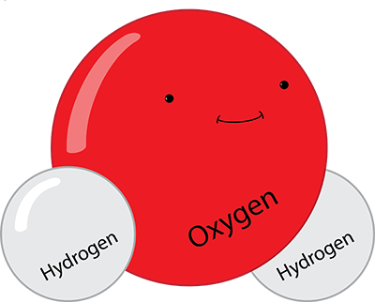
Elements are one type of chemical substance.
Another type of chemical substance is a compound.
Compounds are made up of two or more different atoms held together by a chemical bond.
The smallest particle of a compound is called a molecule.
One water molecule. Two hydrogen atoms bonded with one oxygen atom.
Billions of water molecules.

Slide 9
Atoms of Hydrogen and Oxygen “stick” together in this compound because of chemical bonds.
A chemical bond is a force that holds molecules together. These bonds form when chemical substances react with one another.
_____________________________________________________________________________________________________________________________________________________________________________________________________________________
Types of chemical bonds:
1. Covalent bonds = when atoms share electrons.
2. Ionic bonds = when atoms lose or gain electrons. One atom becomes positively charged (+) and another become negatively charged (-). The attraction between positive and negative hold the atoms together.

Slide 10
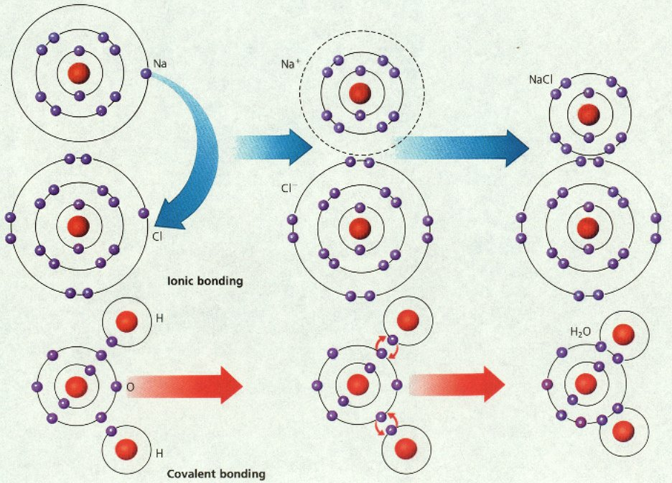
Comparison of bond types.
Ionic bonding - One atom loses an electron and one gains an electron.
Covalent bonding – The atoms share their electrons.

Slide 11
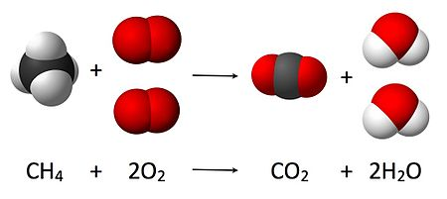
_________________________________________________________________________________________________________________________________________________________________________________________________________________________________________________________________________________________________________
A chemical reaction is a process that changes some chemical substances into other chemical substances.
When this occurs, bonds are broken in the old substance(s) and new bonds are formed in the new chemical substance(s).

Slide 12
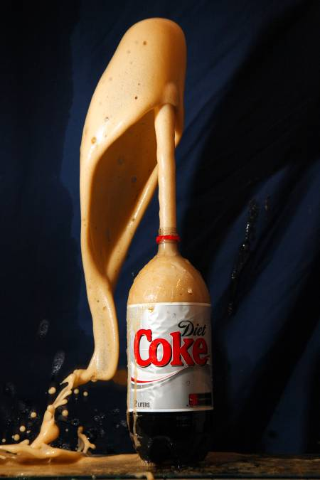
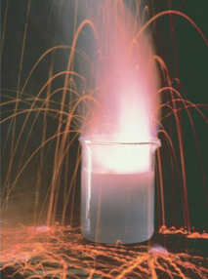
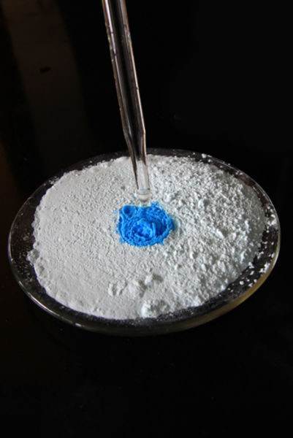
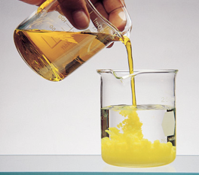
How can you tell if a chemical reaction has occurred between two substances?
1. Color change of a substance or substances.
2. Change in temperature, light, or sound.
3. Detection of an odor.
4. Formation of a gas (bubbles present).
5. Formation of a precipitate (a solid).
1.______________________________________________________________________2.______________________________________________________________________3.______________________________________________________________________
4.______________________________________________________________________
5.______________________________________________________________________

